Slide 1
SCC211 Operation System
(Message Passing)
Zhang Jinyu – zjy@bjtu.edu.cn
School of Computer and Information Technology
SD408

Slide 2

Objectives
Message Passing: Inter-process Communication
– Synchronous
– Asynchronous
– Blocking vs. unblocking
Concurrency using Message Passing
Trade-offs for Message Passing

Slide 3
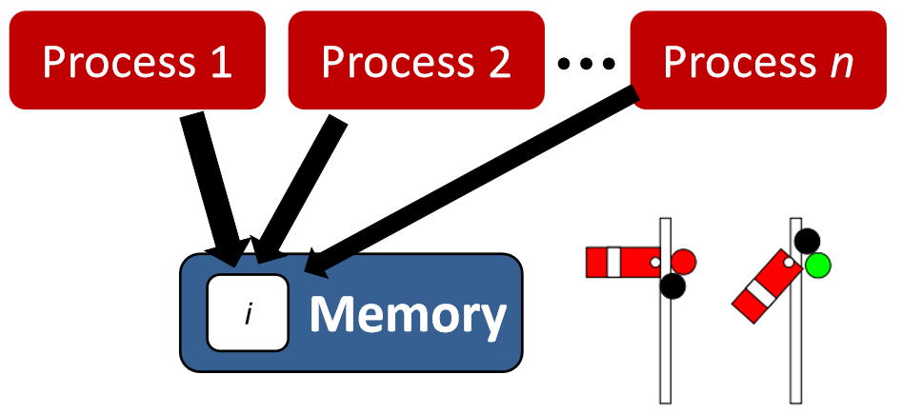
Shared-memory Concurrency

Slide 4
Shared-memory Concurrency
So far we’ve assumed processes access shared resources
This is shared-memory communication
Synchronized statement, locks, mutex, etc.
This doesn’t work for all concurrent programming models
Distributed systems
Unix processes (i.e. not threads!) do not share state
– Spawned processes receive a copy of state of parent process

Slide 5
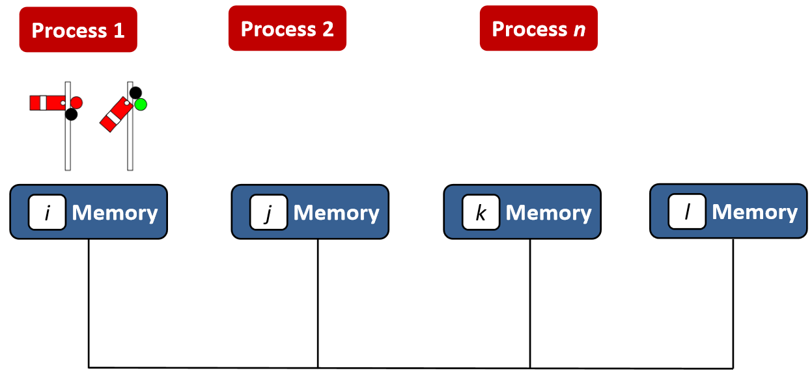
Shared-memory Challenges
Processes in other machines cannot read memory addresses on other machine

Slide 6
Message Passing Definition
Processes communicate by sending & receiving messages using primitives (including synchronization)
This is a form of inter-process communication (IPC)
If two interacting processes are located on same processor, the channel is just the processor’s local memory
If interacting processing are allocated in different processors, the channel is mapped to physical communication medium
Message transfers a number of data items of a certain type from memory of one process to memory of another
流程通过使用原语发送和接收消息进行通信(包括同步)
这是一种进程间通信(IPC)。
如果两个相互作用的进程位于同一个处理器上，通道就是处理器的本地内存
如果在不同的处理器中分配交互处理，则将通道映射到物理通信介质
消息将若干特定类型的数据项从一个进程的内存传输到另一个进程的内存

Slide 7
Communication between
Different threads within a process
Different processes running on the same server
Different processes running on separate servers

Slide 8
Message Passing Details
Each process has access only to its own data
(i.e. all variables are private)
Processes communicate by sending and receiving messages
Data is sent/received on channels
Bi-directional communication link
Must be established between to threads

Slide 9
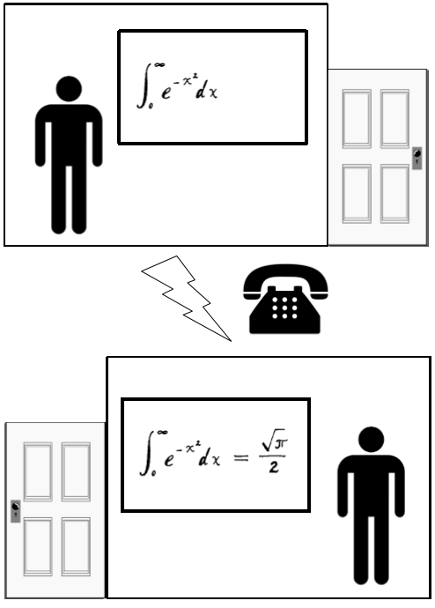
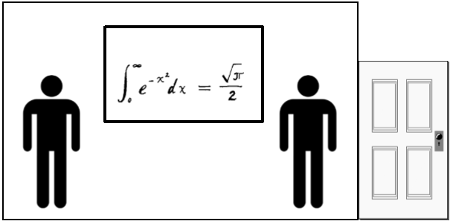
Shared Memory & Message Passing
Shared Memory
Message PassingShared

Slide 10
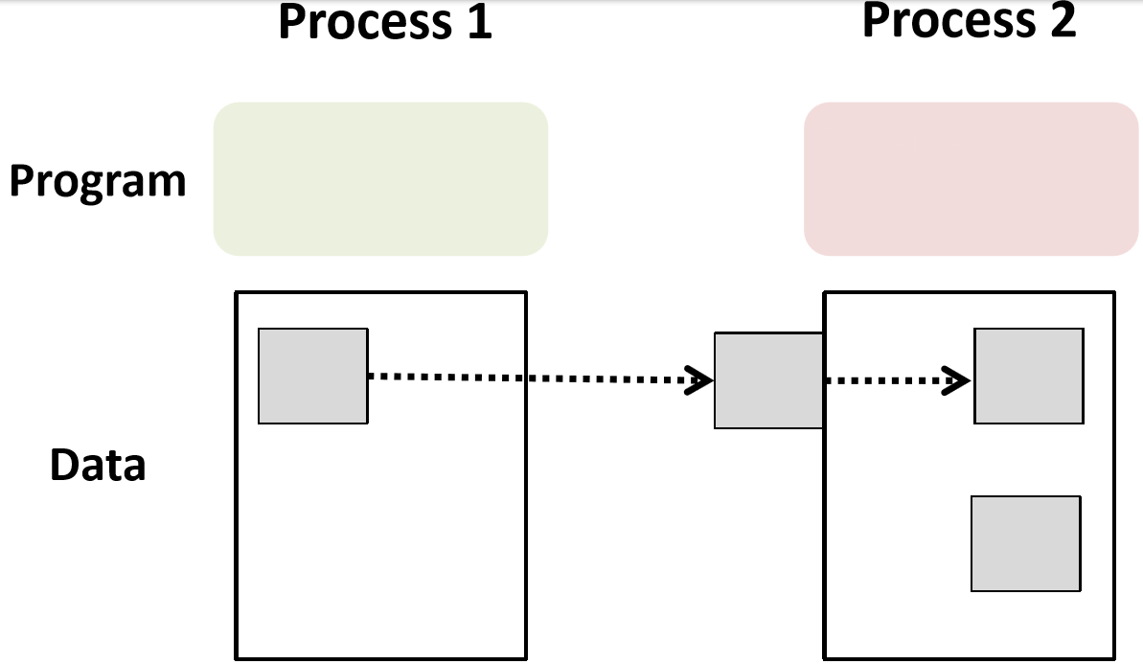
MP Example

Slide 11
Can’t ask “What is the value of i?” in a MP program – need ID
ID of sending processor
Type of data items
Data itself
ID of receiving processor
Number of data items Message type identifier

Slide 12
MP Primitives
Two abstract primitives
Send
send(msg, chan)
Receive
var=receive(chan)
Send message msg to channel chan
Receive a value into local variable var from channel chan
Message Passing can be used in:
Shared memory (threads, monitors) Distributed memory (distributed systems)

Slide 13
Approaches to MP
Uni-directional or bi-directional communication
Source and destination naming is direct or indirect
Source and destination naming symmetrical or asymmetrical
How send() and receive() synchronize

Slide 14
Sync and Async
Processes can send and receive messages (functions, data) to other processes
Synchronous – require the sender and receiver to wait for each other while transferring message
Asynchronous – they do not wait, and carry on their own computation while message transfer is conducted

Slide 15
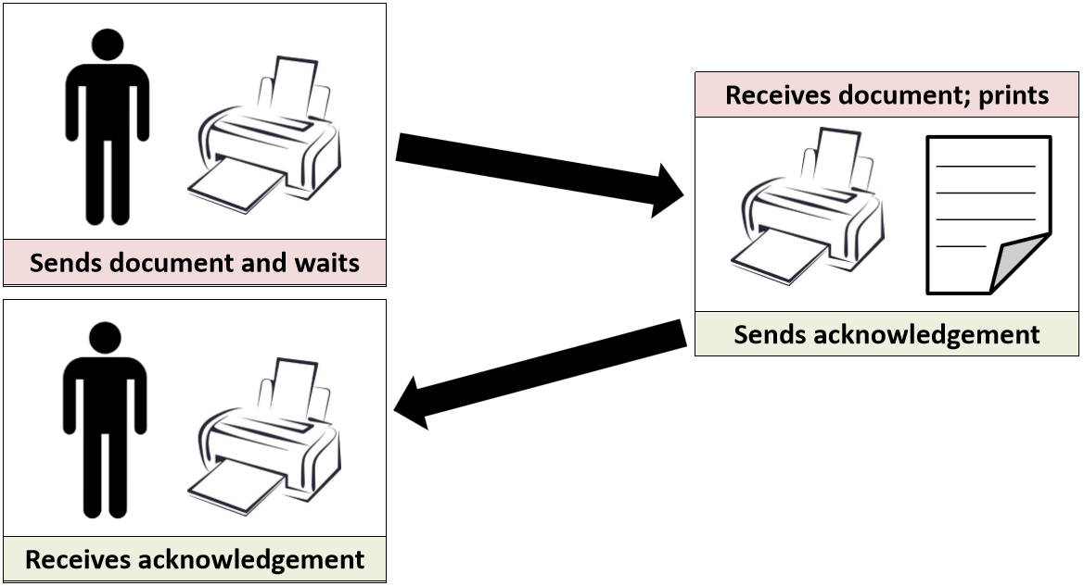
Synchronous MP - Example
Communication does not complete until message has been received

Slide 16
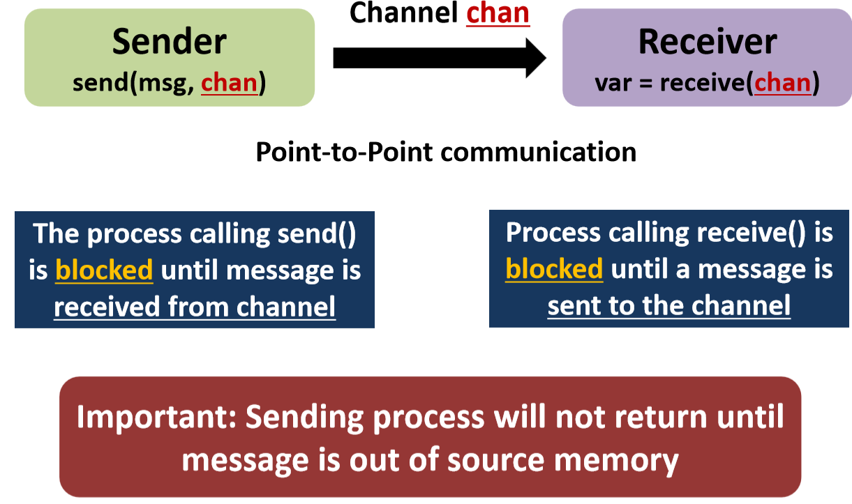
Synchronous Message Passing

Slide 17
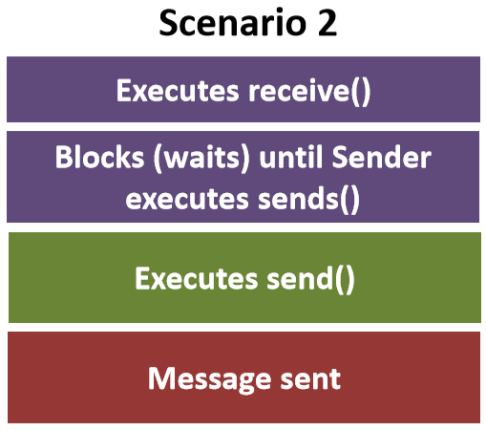
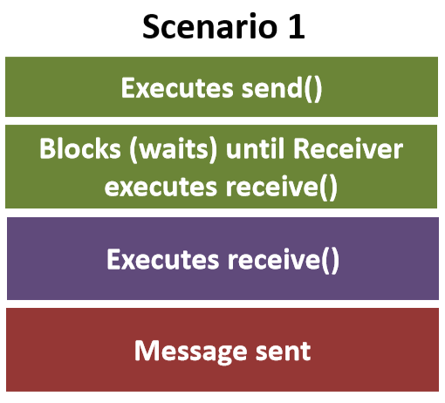
Synchronized MP – Simple Example
Sender()
{ messagetype item;
item = produce_item();
chan.send(item);
}
Receiver()
{ messagetype item;
item = chan.receive();
consume_item(item);
}

Slide 18
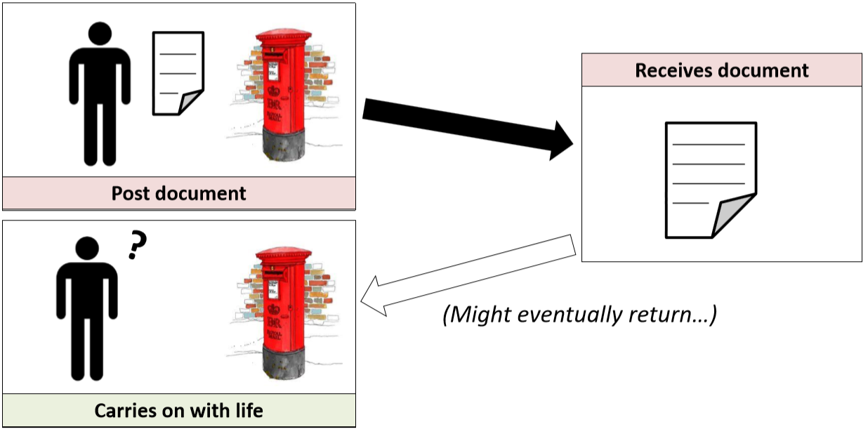
Asynchronous MP - Example
Communication completes as soon as message is sent

Slide 19
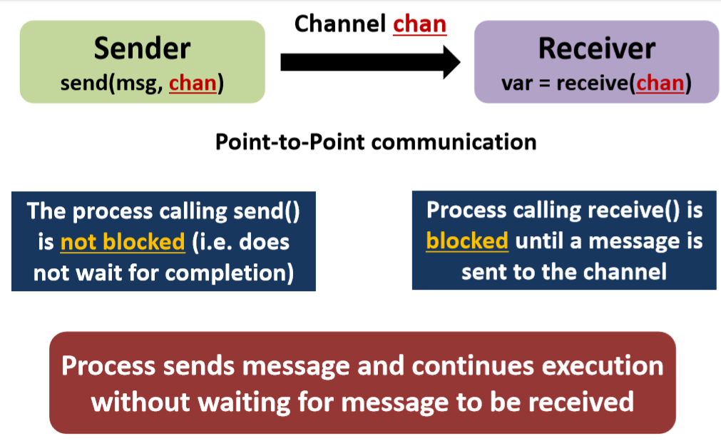
Asynchronous Message Passing
注意：接收者都是blocked

Slide 20
Blocking & Non-blocking
Blocking Operation
Send – Blocks until message received by receiver
Receive – Blocks until message is available
Non-blocking Operation
Send – Process resumes operation immediately after sending
Receive – Receiver retrieves valid message (or returns error)

Slide 21
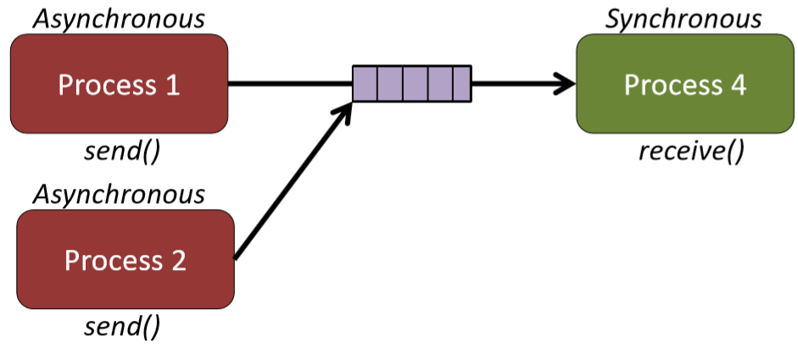
Would this work effectively?
Some form of buffer is deployed for asynchronous Message Passing

Slide 22
Buffering
Message sent by process must be kept in some memory area until receiving machine has received it
- May be kept in senders address space, or receiver address space
- Keep it in senders address space can be time and space efficient (not possible in asynchronous)

Slide 23
Synchronous problems
Reduced concurrency
Whenever two processes communicate, at least one of them will have to block (whichever tries to communicate first)
Client-server interactions
When client releases a resource, usually no reason for waiting until the server has received the release message
When client writes to a device (graphics display) it can usually continue without waiting for the sever to receive the message
降低并发性
每当两个进程通信时，至少有一个进程必须阻塞(无论哪个进程先尝试通信)
客户机-服务器交互
当客户端释放一个资源时，通常没有理由等待，直到服务器收到释放消息
当客户端写入设备(图形显示)时，它通常可以继续而不需要等待服务器接收消息

Slide 24
Asynchronous Problems
Acknowledgement
Receiving process cannot know anything about the current state of the sending process
Sending process has no way of knowing if message was ever received unless the receiving process sends reply
Message communication
̶ Difficult failure detection
̶ Finite buffer space
if too many messages are sent
the program will crash
the buffer will overflow with loss of messages
send operation will block
确认
接收进程无法了解发送进程的当前状态
发送进程无法知道是否收到过消息，除非接收进程发送应答
消息通信-
困难的故障检测．
-有限缓冲空间
如果发送的消息
太多程序会崩溃
由于丢失消息，缓冲区将溢出，
发送操作将阻塞

Slide 25
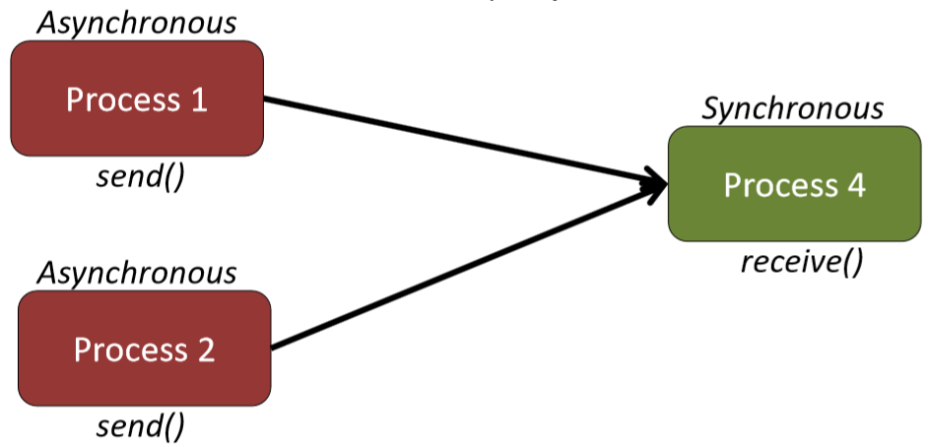
How can this be used to implement concurrency?

Slide 26
Mutual Exclusion with MP
A dedicated process (often termed ‘server’) supervises the critical section and executes on behalf of requesting processes
Process wishing to access critical section sends request to server
Server takes requests serially (thus ensures mutual exclusion)
Executes critical section, and replies to requester
一个专门的进程(通常称为“服务器”)监督临界段并代表请求进程执行
希望访问临界区的进程向服务器发送请求
服务器串行接受请求(从而确保互斥)执行临界段，并响应请求程序

Slide 27
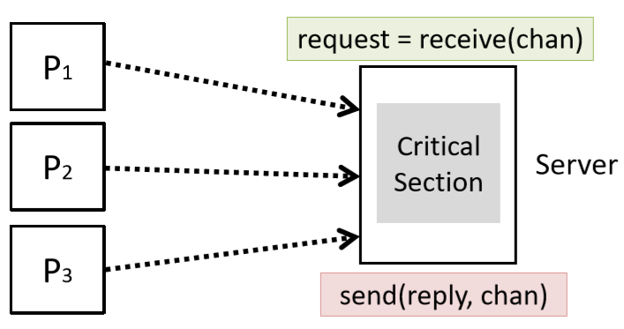

Slide 28
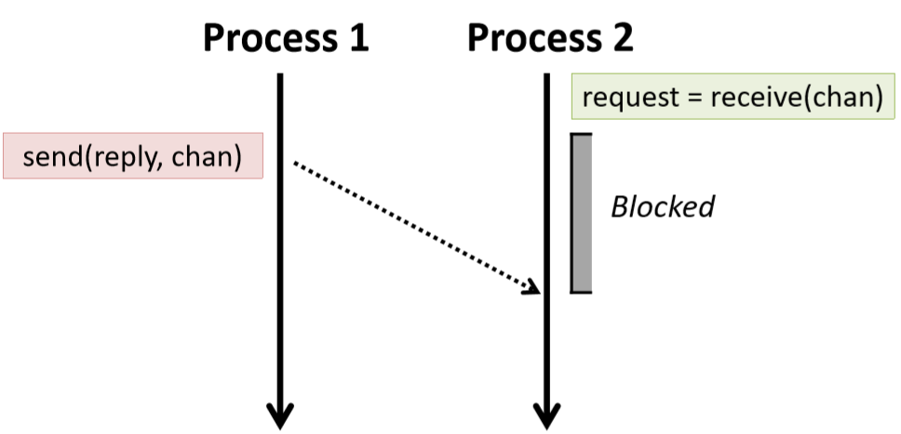
Condition Synchronization with MP
Send a message notifying condition occurrence
receive() is a block operation, thus ensures receiver cannot proceed until sender has sent a notification

Slide 29
MP Code - Synchronous
producer() {
messagetype item;
while (TRUE) {
item = produce_item();
chan.send(item); // send item on channel } }
consumer() {
messagetype item;
while(TRUE) {
item = chan.receive(); // receive item
consume_item(item);
} }
Limitation: Synchronous message-passing model (rendezvous) doesn’t allow the producer to get ahead of the consumer. This limits concurrency

Slide 30
MP Code - Asynchronous
记住
producer() {
messagetype item;
while (TRUE) {
item = produce_item();
credit = credit_chan.receive(); // wait for a credit
data_chan.send(item); // send item } }
consumer() {
messagetype item; // Prime producer with N credits...
for (int i=0 i<N; i++)
credit_chan.send(credit);
while(TRUE) {
item = data_chan.receive(); // receive item
credit_chan.send(credit); // send back credit
consume_item(item); } }
收到credit才生产
receive() still blocks, but send() doesn’t block so can work ahead Throttle producer with ‘credits’ to avoid buffer overrun

Slide 31

Practical Considerations
Performance
When to use blocking / non-blocking?
Reliability
Message loss, incompatible type
Buffering
Whether messages are received in order sent, can take effort
Might time stamps to ensure ordering

Slide 32
Non-determinism
In concurrent programming, often we could select a number of actions, none which are inherently ‘better’
̶ Producer and consumer want to access half-empty/half-full buffer
̶ Handle a request from one of a number of users
在并发编程中，我们通常可以选择许多操作，没有一个操作本身是“更好的”。-
生产者和消费者希望访问半空/半满的缓冲区-
处理来自多个用户中的一个的请求
在编程模型中显式地对这种“不在乎”情况建模是有益的-
阅读代码时容易识别模式
我们可以方便地将“不在乎”的选择委托给系统——替代方案是:
-总是偏爱其中之一，必须通过显式编程随机选择来复杂化你的代码，
It is beneficial to model such “don’t care” situations explicitly in the programming model
̶ Easy to recognise the pattern when reading the code
We have the convenience of delegating the “don’t care” choice to the system - the alternatives would be:
̶ Always favouring one or the other, having to complicate your code by explicitly programming a random choice, etc…

Slide 33
Summary
Message Passing is an entire paradigm
Can be used as an alternative from shared-memory
Also used in OOP
Concurrency is implemented via a server process
Supports both mutual exclusion and condition synchronization
Trades offs between synchronous vs. asynchronous
Sometimes non-determinism isn’t a bug, it’s a feature!

Slide 34
Question？

